Slide 1

The HIL → CAN/J1939 Connection
David C. Johnson
M.S. Bradley University

Slide 2
CAN (Controller Area Network)
— Physical + Data‑Link Layer
Multi‑master serial communication bus
used in vehicles/heavy equipment. It defines:
Electrical signaling
Bit timing and arbitration
Error detection
Message frames
Bus/Network topology
CAN does not define what the data means.
but … how bits move across the wire.

Slide 3
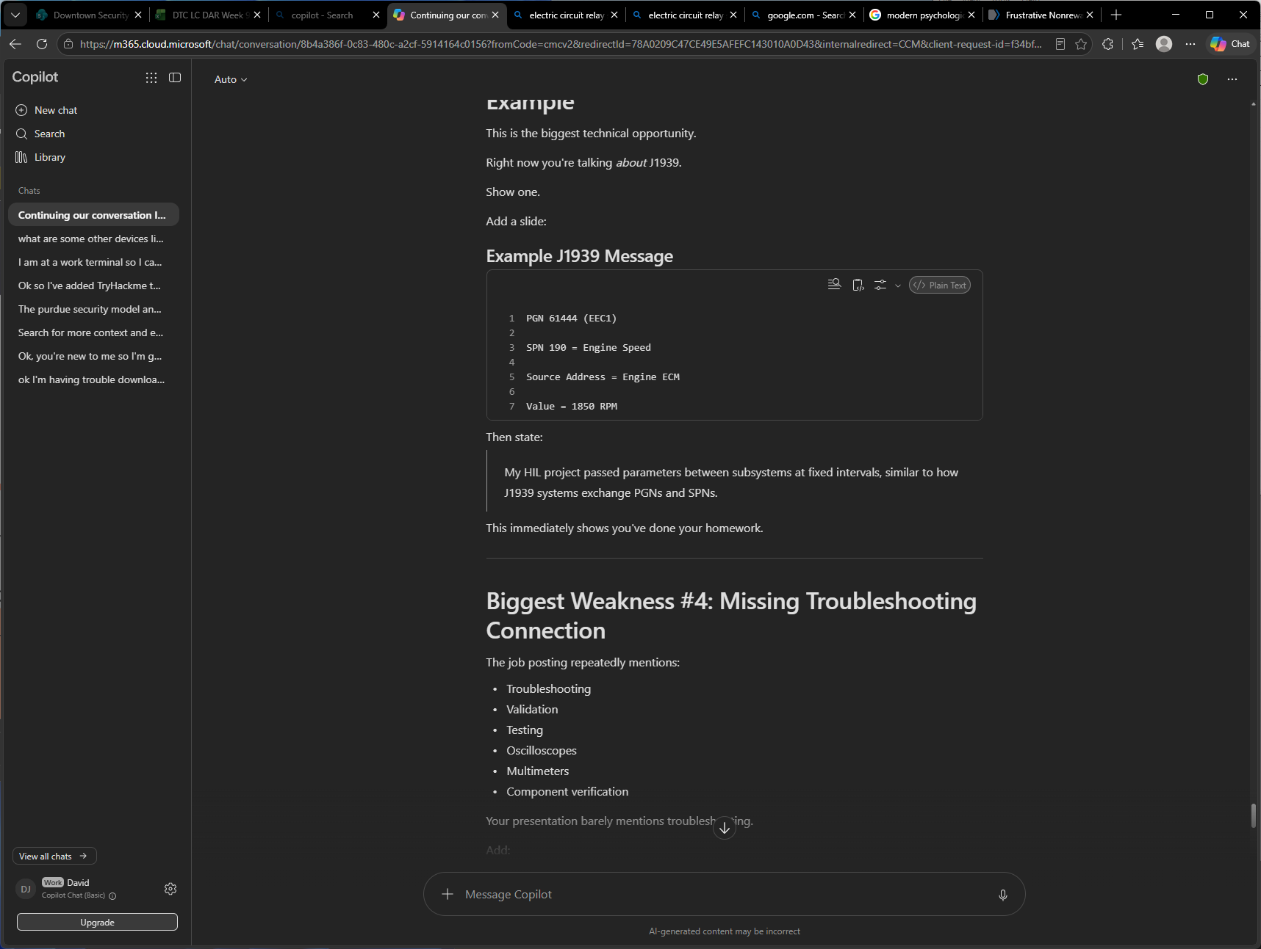
(PGN) Parameter Group Number/type of message
Suspect Parameter Number/specific param. In PGN

Slide 4
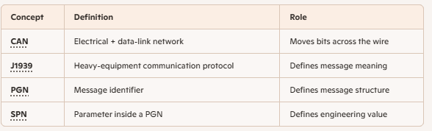

Slide 5
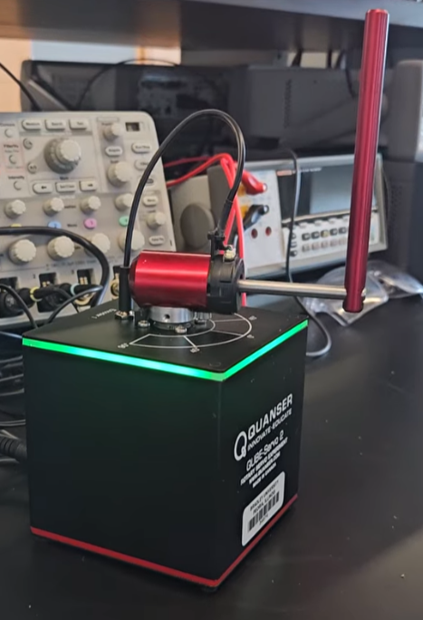
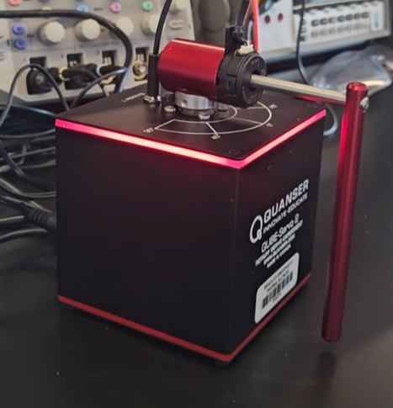
Quanser QUBE Servo2
https://youtube.com/shorts/SxaPog4d3mc?si=bGdqS_M4bg5FTxAh

Slide 6
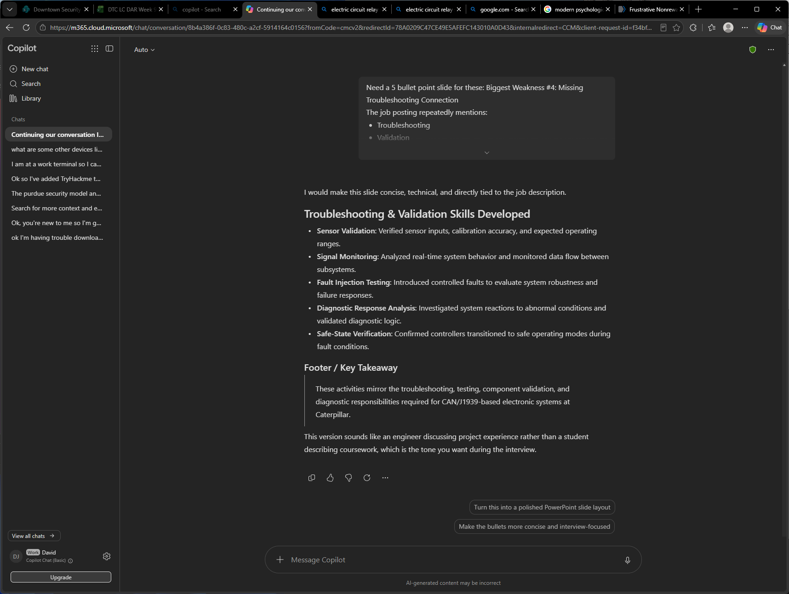

Slide 7
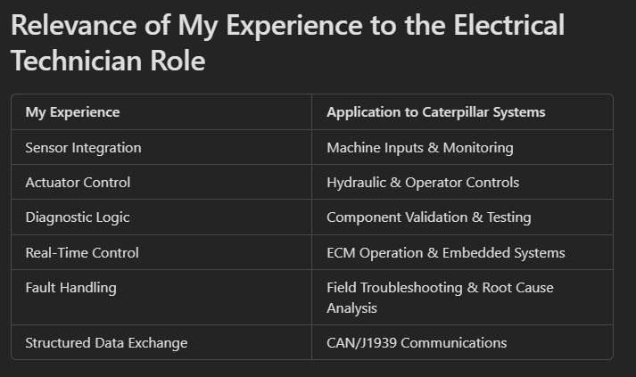

Slide 8
My Quanser QUBE‑Servo2/Fault Handling & Diagnostics
Built: real‑time control system in MATLAB/Simulink Behaved like a J1939‑based ECU
The HIL environment incorporated:
Fault detection/Saturation limits/Diagnostic responses
/State-Safe Transitions/Timing Constraints
Same architecture Caterpillar uses in its engine, transmission, and hydraulic controllers.

Slide 9
Simulink Subsystems model
Structured Data Exchange
Functioned like PGNs and SPNs…
Pendulum angle/Angular velocity/Control output/Stability flags were all parameters exchanged at fixed rates.
…. like J1939 messages such as EEC1 or ETC1.
Injected energy to swing the arm upright/stabilized it! Implementing torque‑control logic a J1939 engine controller uses — Parameters exchanged at fixed intervals.

Slide 10
My HIL model…..
Included fault handling, saturation limits, and safe‑state transitions, which
map directly to J1939 diagnostics like DM1 and DM2.
System ran on a fixed‑step solver it had to maintain strict timing discipline, similar to the 10‑ms and 50‑ms broadcast rates used in heavy‑equipment networks.

Slide 11
While not …
….explicitly decoding PGNs or SPNs
project required thinking and operating exactly like an embedded engineer working with J1939: ….structured data exchange, deterministic timing, real‑time control loops, and robust diagnostic behavior. That’s why transitioning into CAN/J1939‑based embedded or validation work is my DEFINITE NEXT STEP!!

Slide 12
My HIL Experience developed skills:
Deterministic Control
Diagnostics
Structured data exchange
Real-Time system validation
Thank You

